Slide 1


Sustainable Urban Transport: Optimising Traffic Flow, Safety and Carbon Emission on an Urban Highway Corridor of Bangladesh
Research Title
HUSSEIN MD TANVEER
M250436
HIROSHIMA UNIVERSITY

Slide 2
Research objectives:
To evaluate the performance regarding efficiency, safety and emission of the highway corridor.
To optimise the efficiency, safety and emission parameters.

Slide 3
Research inspiration
What an urban highway should cater primarily?
Mobility for transit vehicles?
or
Accessibility and mobility for urban commuters?

Slide 4
Why an Urban Highway Corridor?
In Bangladesh, most of the delays occur in the built up sections of any highway corridor.
The need to traverse the corridor due to economic activities, augmented by the cultural behaviour of pedestrians and vehicle movement disrupt traffic flow

Slide 5
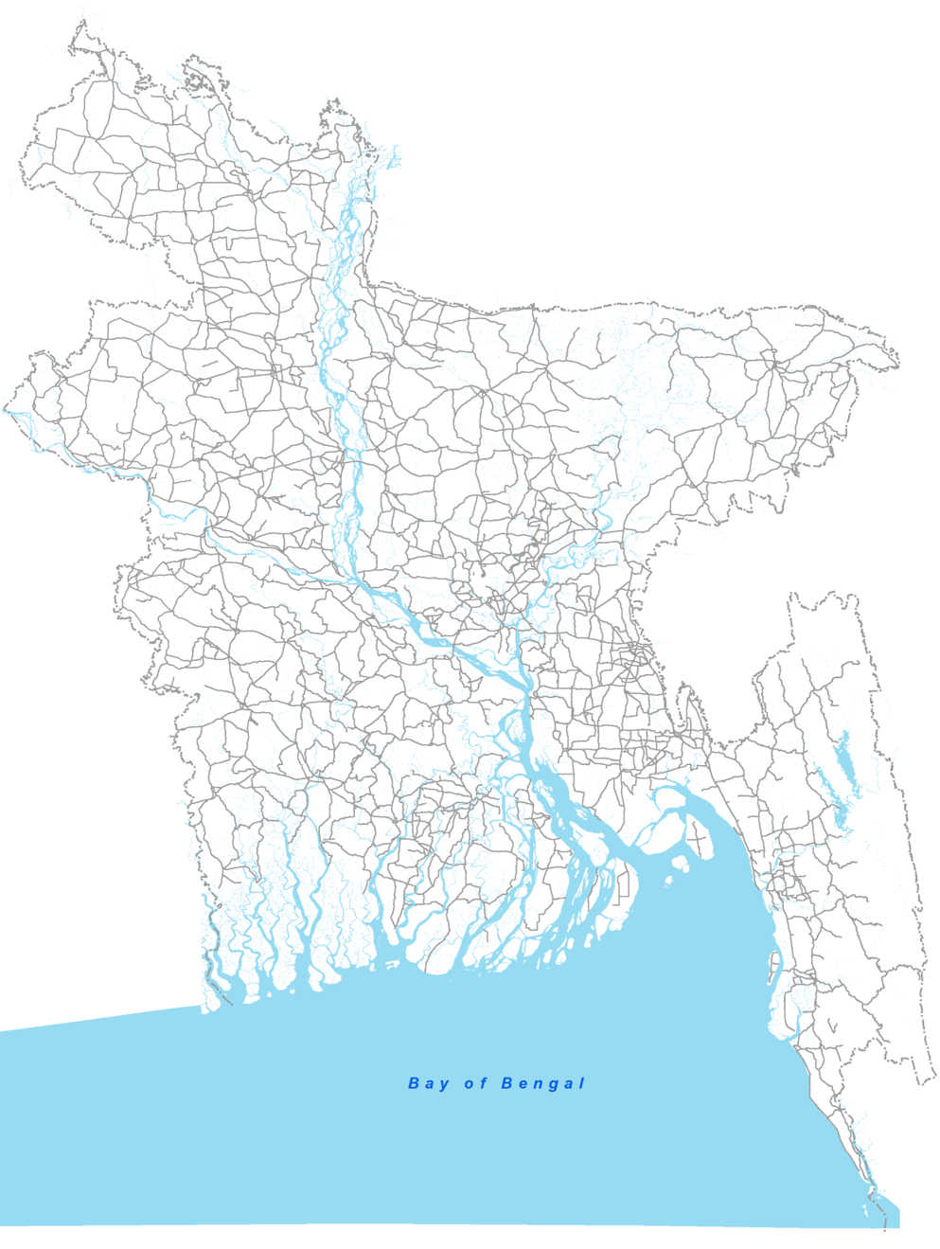
Location of the proposed
highway corridor

Slide 6

Location of the proposed
highway corridor

Slide 7
Video of Highway

Slide 8
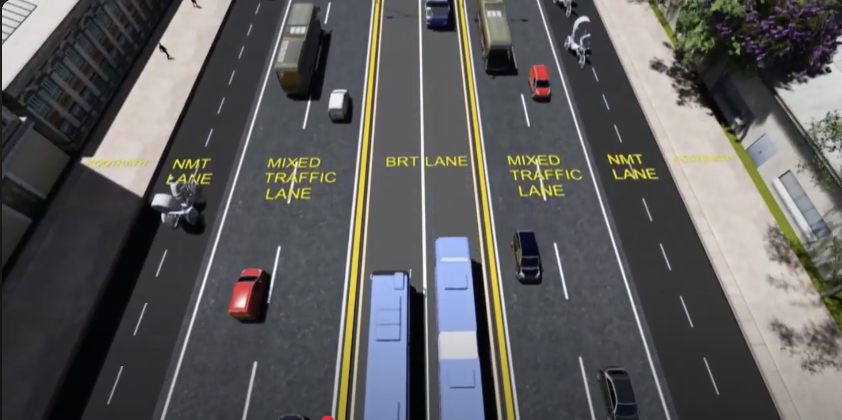

Slide 9
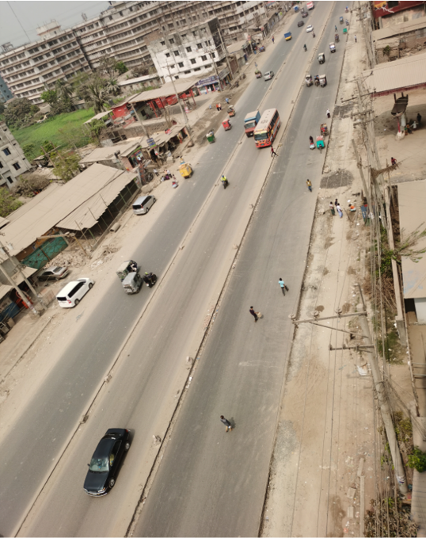
Present condition

Slide 10
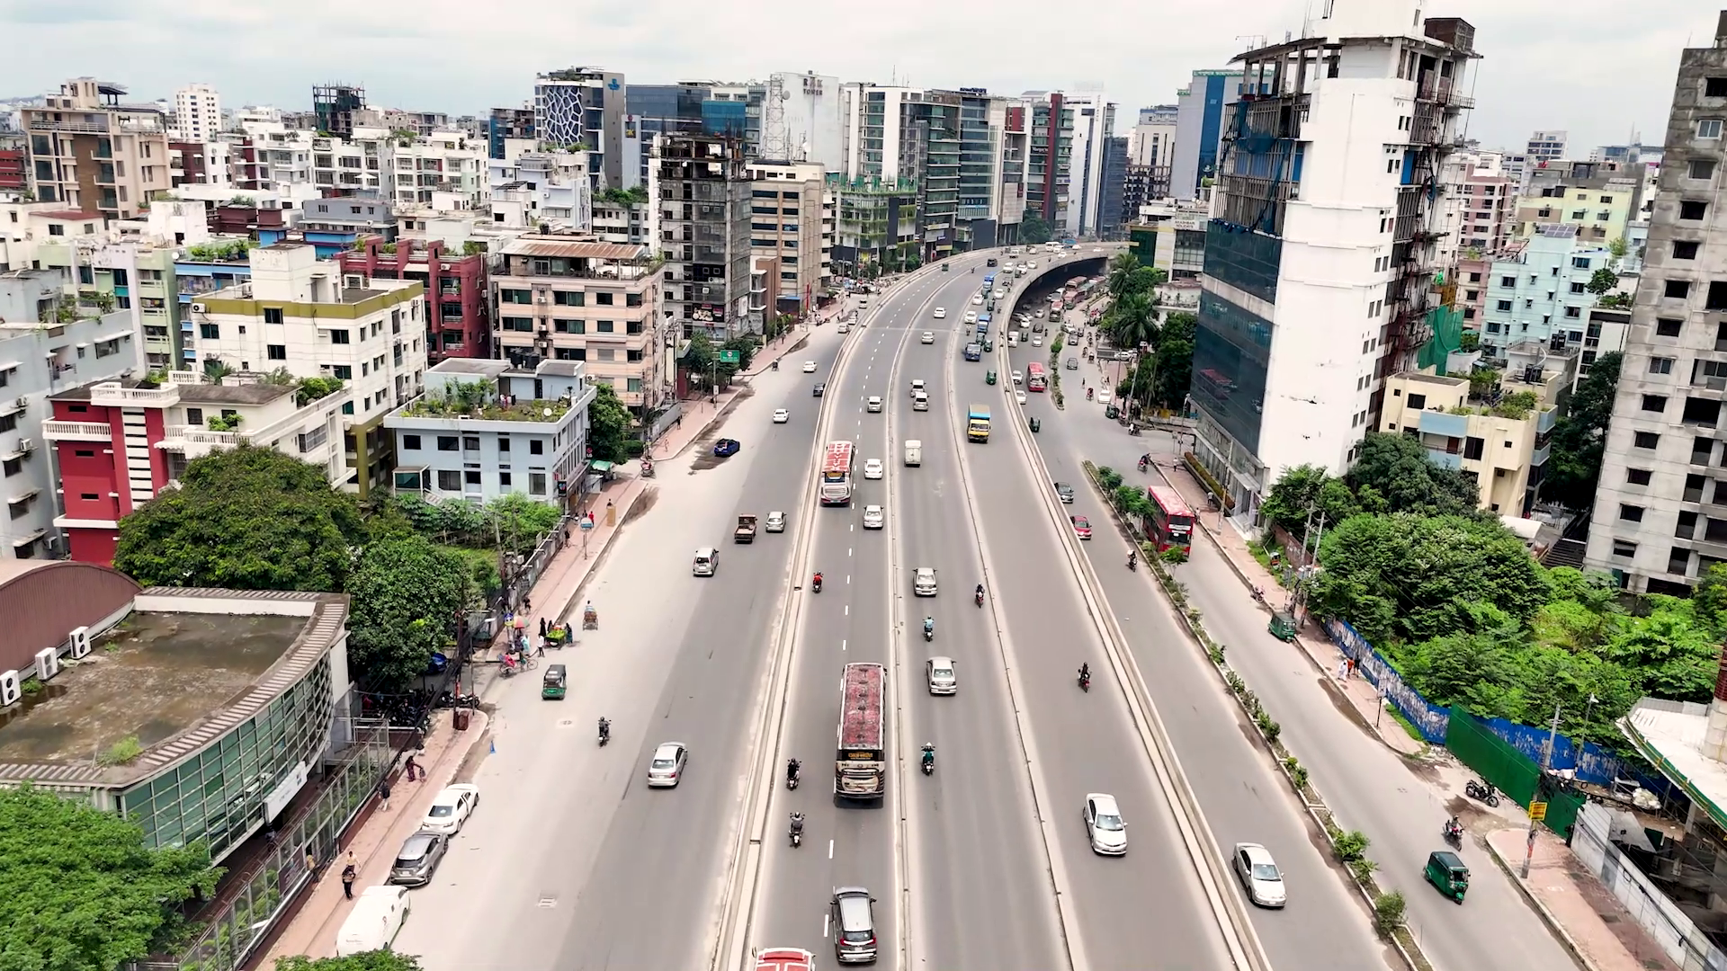
Present condition

Slide 11
What to measure?
Baseline data
Traffic flow: Delay, Level of Service
From real time data by video surveillance
Traffic Safety: time to collision (TTC), modified time to collision (MTTC), and headway
By applying surrogate safety measures
Emission: GHG emission/ fuel consumption
From vehicle speed and emission rate

Slide 12
Optimisation between scenarios
After selecting a suitable section representing the corridor, a simulation model will be developed with VISSIM software. After the model is validated, another model will be created by introducing an HOV lane instead of the BRT lane
Finally, this research will optimise the efficiency, safety and emission parameters to drive a sustainable shift towards a smart city.
For forecasting purposes, the model will be analysed for different scenarios representing different geometric configurations and time intervals. A multi-criteria decision analysis, such as Genetic Algorithm (GA) or Non-dominated sorting genetic algorithm II (NSGA-II) , may be applied to optimise efficiency, safety, and emissions.

Slide 13
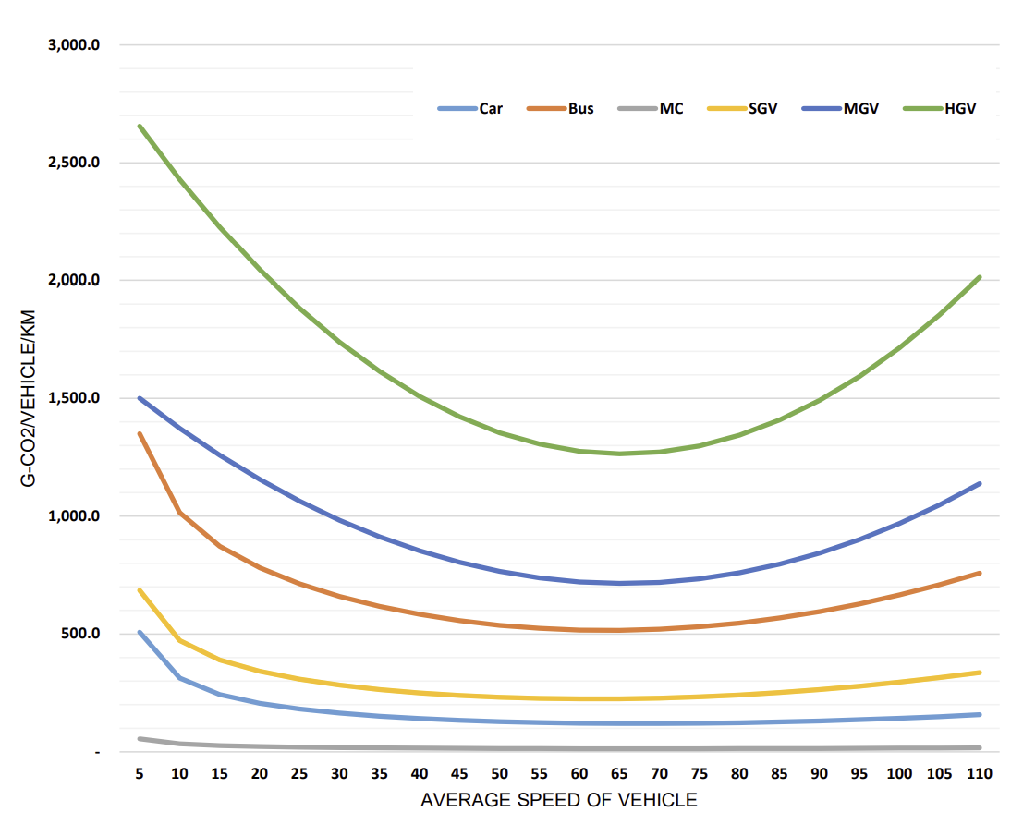
Base Emission Factors by Vehicle Type
Measuring Emission
The relationship between vehicle speed and emission rate, as measured by the Public Works Research Institute of Japan (PWRI)
Source: Bangladesh Highway Masterplan 2041

Slide 14
Methodology Flow:
1. Define Study
Urban highway corridor & representative section
2. Data Inputs
Video surveillance + RHD/BRT/BBS/survey data
3. Video Analytics
Vehicle detection, tracking & trajectory extraction
4. Measure Performance Indicators
Traffic Flow Count · Speed · Density
Traffic Safety TTC · MTTC · PET
Emission GHG emission
5. Build Baseline Microsimulation
Develop VISSIM model for the selected highway section
6. Calibrate & Validate
Match simulated outputs with video-derived field measures
7. Scenario Design
Replace BRT lane with High Occupancy Vehicle lane
8. Scenario Analysis
Compare geometric layouts & time intervals
iterate until validation acceptable
9. Multi-objective Optimisation
GA / NSGA-II for efficiency, safety and emissions
10. Select Optimised Solution
Identify best lane configuration & operational strategy
11. Research Output
Optimised corridor performance for sustainable urban mobility
Decision criteria: minimise delay/congestion, reduce traffic conflicts, and lower GHG emissions while improving corridor efficiency.
Prepared from research plan: Optimising Traffic Flow, Safety and Carbon Emission on an Urban Highway Corridor of Bangladesh

Slide 15
Comments from Previous Meetings:
Reem san:
Start reading papers/articles on relevant topics, to decide on the parameters you want to measure
Scope of the research is too wide to be covered within the duration of a Master course
Azis san:
Focus on Safety analysis part involving Traffic Conflict Technique (Surrogate Safety Measures).
Start learning to work on the Simulation software (PTV-Vissim).

Slide 16
Papers on Traffic Flow
Title | Author | Parameters | Method
A real-time computer vision sysrem for vehicle tracking and traffic surveillance | Coifman et al | Traffic Count, Density, Speed | Feature based tracking
Traffic flow estimation with data from a video surveillance camera | Federov et al | Traffic Count | SSD
Vision-based vehicle detection and counting system using deep learning in highway scenes | Huansheng et al | Traffic Count | YOLOv3

Slide 17
Papers on Traffic Safety
Title | Author | Parameters | Method
A bivariate, non-stationary extreme value model for estimating opposing-through crash frequency by severity by applying artificial intelligence-based video analytics | Howlader et al | Gap time (GT), TTC, PET | YOLOv3, Deep SORT
Spatial–Temporal Video Analysis For Advanced Traffic Conflict Detection And Risk Assessment Using Yolov8 And Attention-Enhanced Safety Metrics | Singh et al | TTC, PET, DRAC | YOLOv8, Deep SORT
An automated surrogate safety analysis at protected highway ramps using cross-sectional and before–after video data | Paul et al | TTC | Feature based, Traffic Intelligence (Open Source)
A systematic review of traffic conflict-based safety measures with a focus on application context | Arun et al | All possible parameters | Meta study

Slide 18
Next step
Continue reading papers
Learning video processing using YOLO + Deep SORT
Preparing Specification of Camera Set-up to be installed in Bangladesh

Slide 19
Comments from 28 April 2026 Meeting:
Azis san:
Include the process of estimating traffic flow, traffic safety (TTC, MTTC) and emission from video data.
For acquiring video data please make sure that all the administrative conditions are met both in Japan and Bangladesh

Slide 20
Progress update (13th May)
Tasks from Previous meeting | Comment from group B | Update
Continue reading papers |  | ongoing
Learning video processing using YOLO + Deep SORT |  | Installed VS Code, learning is ongoing. Detecting the traffic is ongoing.
Preparing Specification of Camera Set-up to be installed in Bangladesh |  | Minimum HD (Preferably 4k) Frame rate 30 FPS or higher Camera Mount Height minimum 8 meters
 | Include the process of estimating traffic flow, traffic safety (TTC, MTTC) and emission from video data. | Ongoing
 | For acquiring video data please make sure that all the administrative conditions are met both in Japan and Bangladesh | Ongoing
 |  | Installed PTV VISSIM and obtained Student License.

Slide 21
Methodology Flow:
1. Define Study
Urban highway corridor & representative section
2. Data Inputs
Video surveillance + RHD/BRT/BBS/survey data
3. Video Analytics
Vehicle detection, tracking & trajectory extraction
4. Measure Performance Indicators
Traffic Flow Count · Speed · Density
Traffic Safety TTC · MTTC · PET
Emission GHG emission
5. Build Baseline Microsimulation
Develop VISSIM model for the selected highway section
6. Calibrate & Validate
Match simulated outputs with video-derived field measures
7. Scenario Design
Replace BRT lane with High Occupancy Vehicle lane
8. Scenario Analysis
Compare geometric layouts & time intervals
iterate until validation acceptable
9. Multi-objective Optimisation
GA / NSGA-II for efficiency, safety and emissions
10. Select Optimised Solution
Identify best lane configuration & operational strategy
11. Research Output
Optimised corridor performance for sustainable urban mobility
Decision criteria: minimise delay/congestion, reduce traffic conflicts, and lower GHG emissions while improving corridor efficiency.
Prepared from research plan: Optimising Traffic Flow, Safety and Carbon Emission on an Urban Highway Corridor of Bangladesh

Slide 22
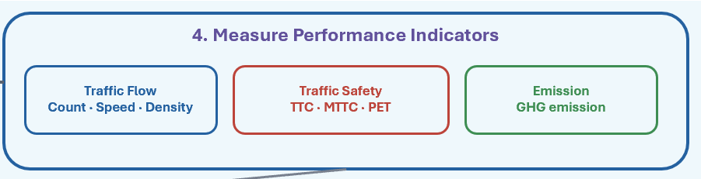
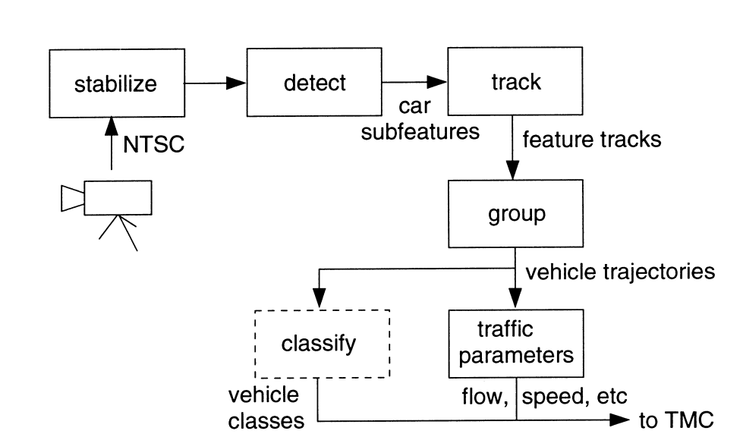
Flow Chart for Measuring Performance Indicators (Generic)
Ref:
Coifman, B., Beymer, D., McLauchlan, P., & Malik, J. (1998). A real-time computer vision system for vehicle tracking and traffic surveillance. Transportation Research Part C: Emerging Technologies, 6(4), 271–288. https://doi.org/10.1016/S0968-090X(98)00019-9

Slide 23
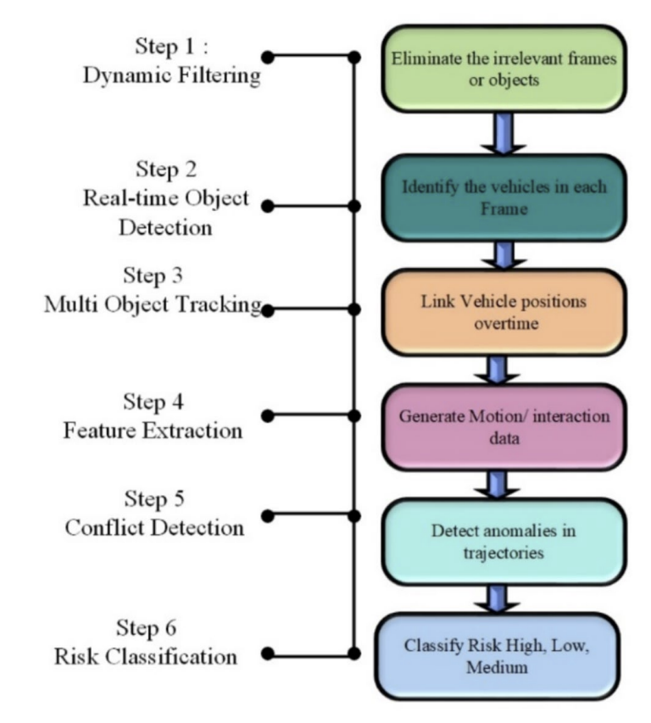
Flow Chart for Measuring Performance Indicators (Using YOLO)
Ref:
Singh, A., & Dass, S. (2025). Spatial–temporal video analysis for advanced traffic conflict detection and risk assessment using YOLOv8 and attention-enhanced safety metrics. International Journal of Intelligent Transportation Systems Research, 23, 2252–2272. https://doi.org/10.1007/s13177-025-00572-y

Slide 24
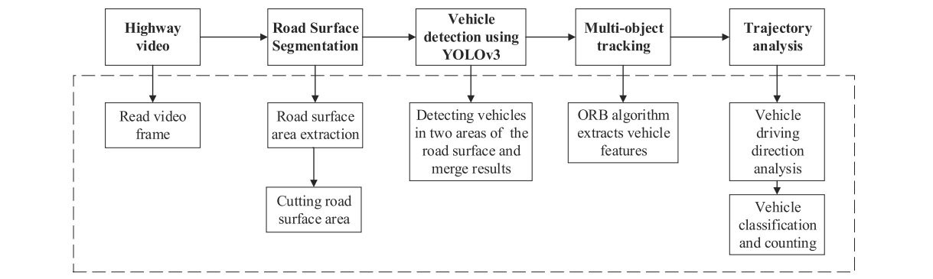
Flow Chart for Measuring Performance Indicators (Using YOLO)
Ref:
Song, H., Liang, H., Li, H., Dai, Z., & Yun, X. (2019). Vision-based vehicle detection and counting system using deep learning in highway scenes. European Transport Research Review, 11, Article 51. https://doi.org/10.1186/s12544-019-0390-4

Slide 25
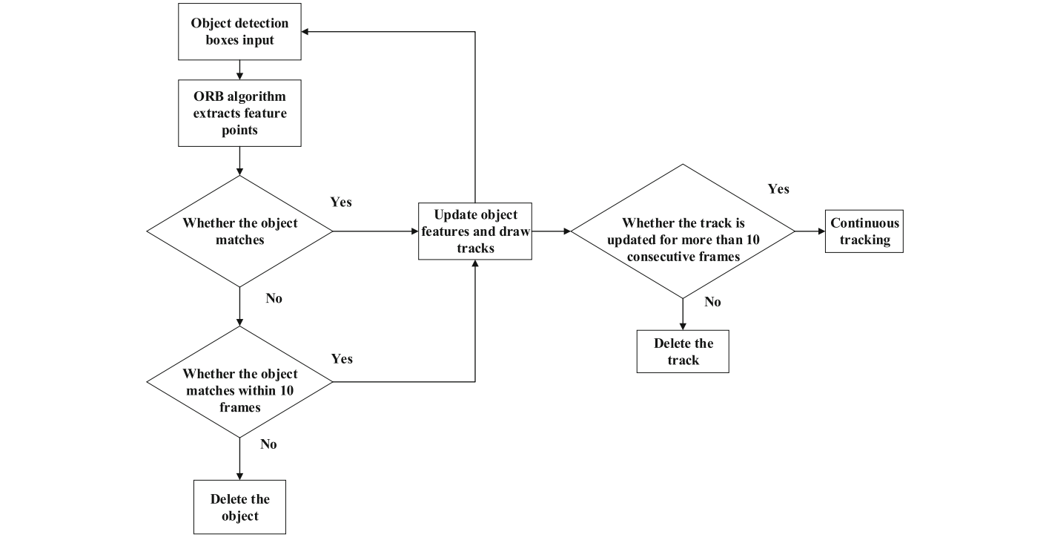
Flow Chart for Measuring Performance Indicators (Multi Object)
Ref:
Song, H., Liang, H., Li, H., Dai, Z., & Yun, X. (2019). Vision-based vehicle detection and counting system using deep learning in highway scenes. European Transport Research Review, 11, Article 51. https://doi.org/10.1186/s12544-019-0390-4

Slide 26
Progress update (20th May)
Tasks from Previous meeting | Comment from group B | Update
Continue reading papers |  | ongoing
Try to acquire image from higher elevation and wider angle and run the script to detect the vehicles, | Measure the accuracy with manual counting. | Draft video presented with counting

Slide 27
Progress update (^{12th} June 2026)
Tasks from Previous meeting | Comment from group B | Update
Continue reading papers |  | ongoing
Try to acquire image from higher elevation and wider angle and run the script to detect the vehicles, | Measure the accuracy with manual counting. | Draft video presented with counting

Slide 28
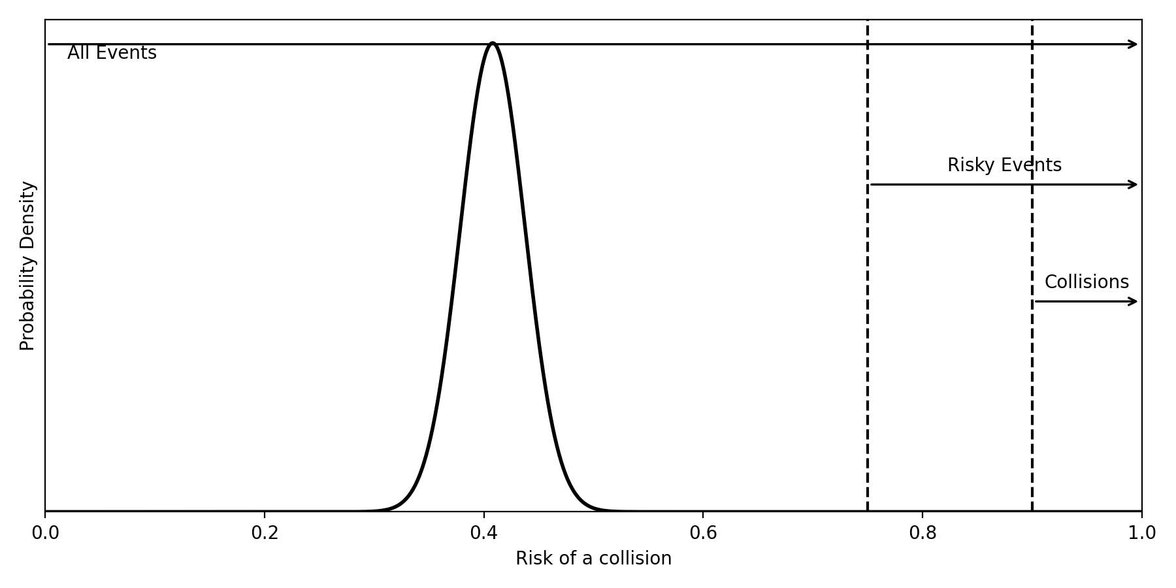
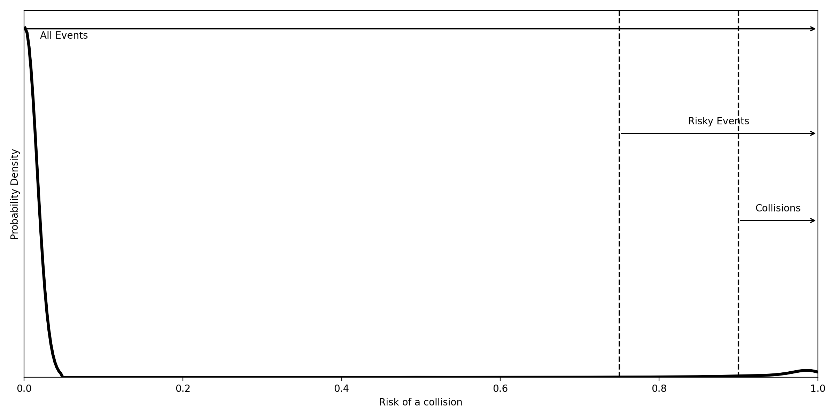

Slide 29
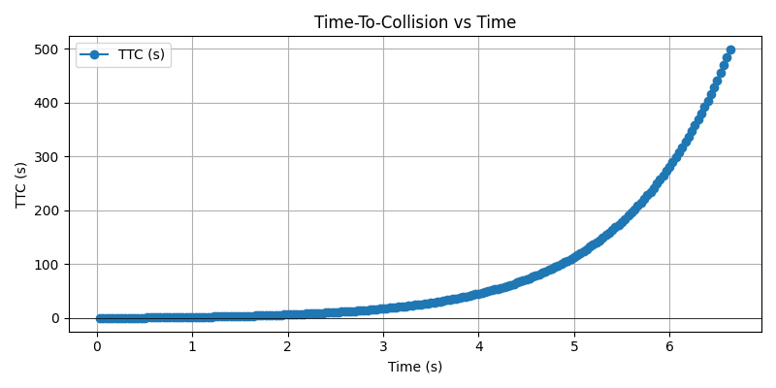

Slide 30
Thank you

